Slide 1
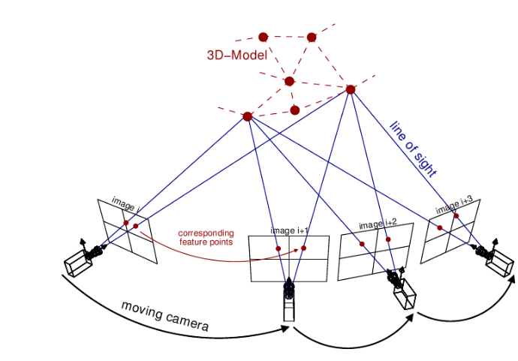

Slide 2
SLAM with Objects using a Nonparametric Pose Graph
Beipeng Mu, Shih-Yuan Liu, Liam Paull, John Leonard, onathan P. How
IROS 2016
Probabilistic Data Association for Semantic SLAM
Sean L. Bowman, Nikolay Atanasov, Kostas Daniilidis, George J. Papas
ICRA 2017
Sher and Alon

Slide 3
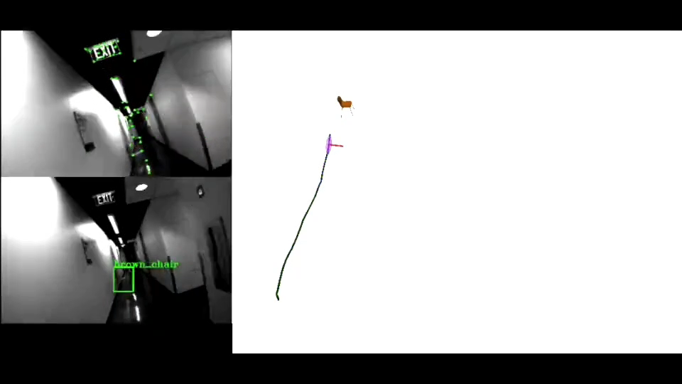
What is semantic slam
Probabilistic Data Association for Semantic SLAM
ICRA 2017

Slide 4
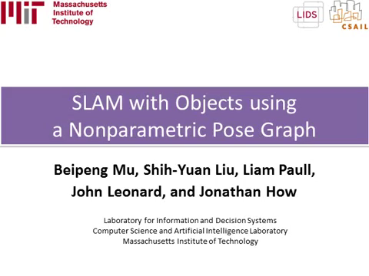
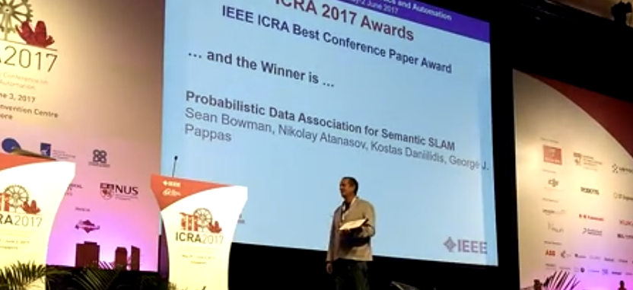

Slide 5
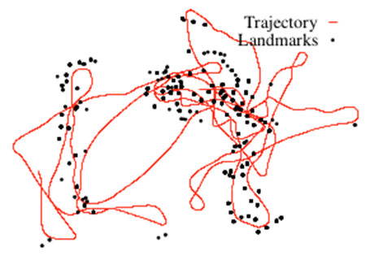
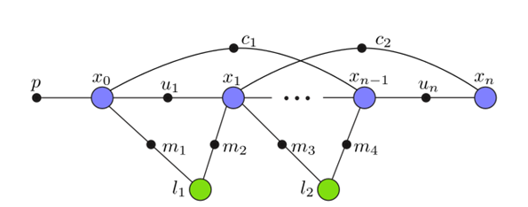
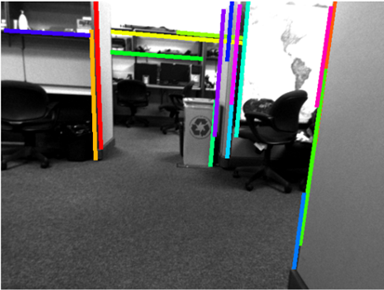
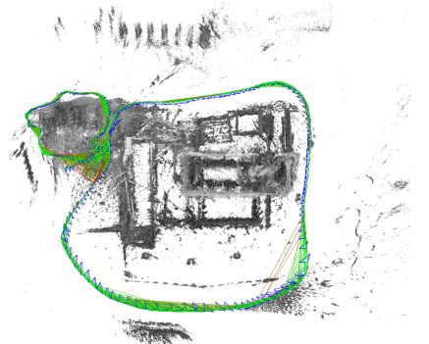
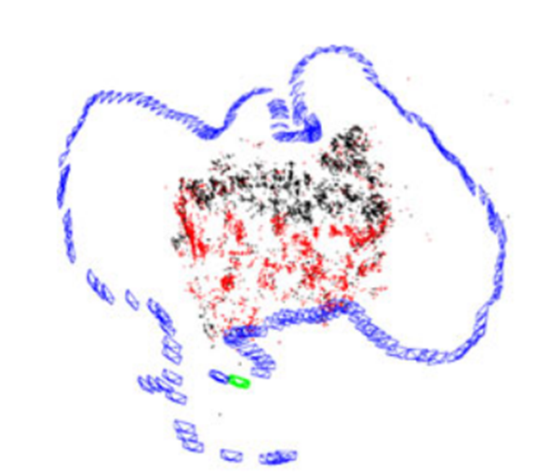
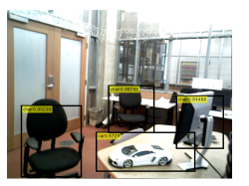
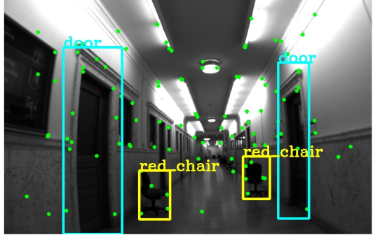
2011
When did the community start working on Semantic Slam
Graph Optimization Toolboxes
2013
2011: g2o
Kalman Filter Semantic SLAM
2012: ISAM2
2014
2013: EKF SLAM using Line Observations (Dimitrios G. Kottas)
Geometrical SLAMS with graph optimization
2014: LSD-SLAM
2015: ORB-SLAM
2016
Semantic Slams
With graph optimization
2016: SLAM with Objects using a Nonparamteric Pose Graph
2017: Probabilistic Data Association for Semantic SLAM

Slide 6
2011
When did the community start working on Semantic Slam
Graph Optimization Toolboxes
2013
Computer vision outburst
YOLO ARTICLE
2016
Semantic Slams
With graph optimization
2016: SLAM with Objects using a Nonparamteric Pose Graph
2017: Probabilistic Data Association for Semantic SLAM

Slide 7

What are the advantages of Semantic Slam
$$→better mapping$$
$$→better localization$$

Slide 8
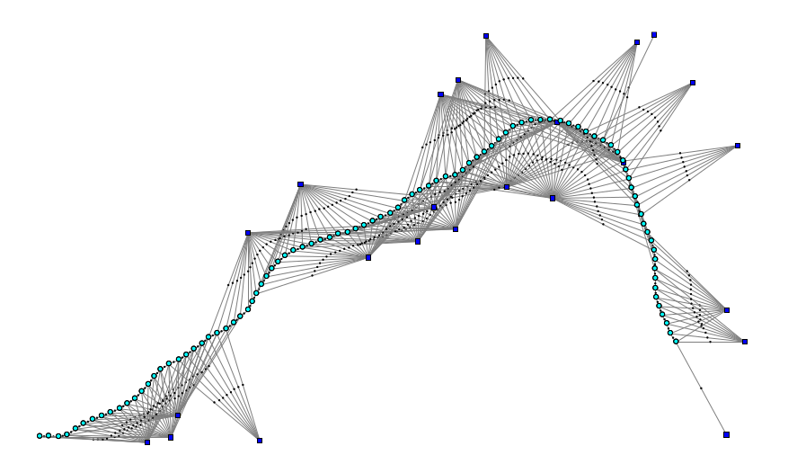

Geometrical Pose Slam Optimization Problem
Landmarks
Measurement
Poses
Odometry

Slide 9
What are the advantages and challenges of semantic SLAM
Geometrical Pose Slam Optimization Problem
Landmarks
Measurement
Poses
Odometry

Slide 10
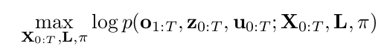
What are the advantages and challenges of semantic SLAM
Semantic Pose Slam Optimization Problem
Landmark Classes
Landmarks Positions
Geometrical Measurement
Pose
Class measurement
Odometry

Slide 11
Geometrical
State With Measurements
Semantic
Slam optimization - backend

Slide 12
Main Contribution
Point 1
point2

Slide 13
METHOD

Slide 14
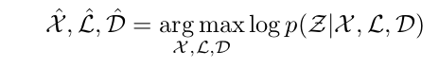
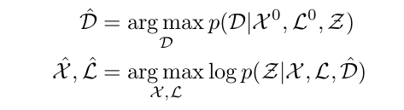

Slide 15
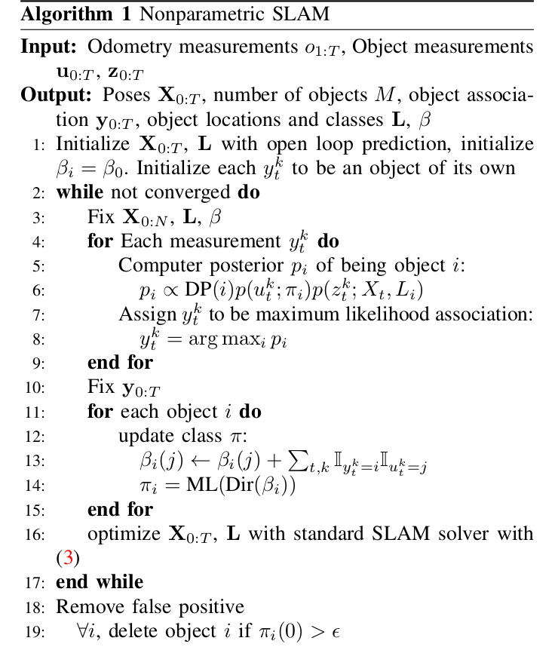

Slide 16
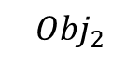
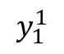
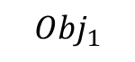
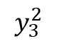
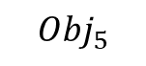
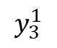
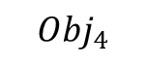
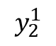
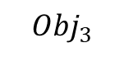
Ground Truth
$${Obj}_{4}$$
$$y_{3}^{2}$$
$${Obj}_{3}$$
8 objects
M objects
$$y_{3}^{1}$$
$${Obj}_{2}$$
$$y_{2}^{1}$$
$$y_{1}^{1}$$
$${Obj}_{1}$$
$${Obj}_{5}$$

Slide 17
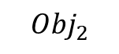

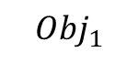
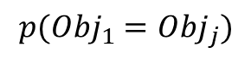
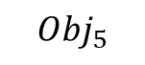

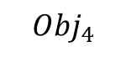

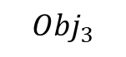
$${Obj}_{4}$$
$${Obj}_{3}$$
$${Obj}_{2}$$
$${Obj}_{1}$$
$${Obj}_{5}$$
$$p\left(u_{t}^{k} | π_{i}\right)p\left(z_{t}^{k} | X_{t},L_{i}\right)=f\left(class\right)∗f(space)$$
$$p({Obj}_{1}={Obj}_{j})$$
$$2$$
$$3$$
$$4$$

Slide 18
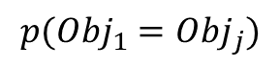
$${Obj}_{4}$$
$${Obj}_{3}$$
$${Obj}_{2}$$
$${Obj}_{1}$$
$${Obj}_{5}$$
$$p\left(u_{t}^{k} | π_{i}\right)p\left(z_{t}^{k} | X_{t},L_{i}\right)=f\left(class\right)∗f(space)$$
$$p({Obj}_{1}={Obj}_{j})$$
$$2$$
$$3$$
$$4$$

Slide 20
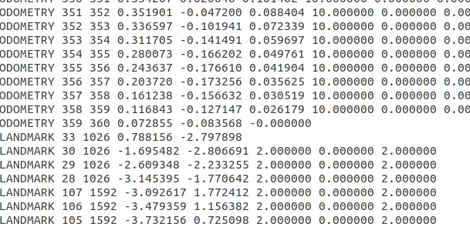

Slide 23
Experiment

Slide 24
Our Simulation

Slide 25
Conclusions

